Slide 1


OMACHONU JOSEPH ATANU 22- JANUARY-2026
LEVEL 2 - TALENT IDENTIFICATION IN F OO TB ALL 1
JUVENTUS VS DORTMUND OPPOSITION REPORT
NAME
D AT E

Slide 2

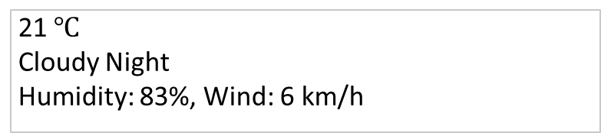
MATCH REPORT
SCOUTING REPORT
Focus of the report – DORTMUND
4
VS
4
JUVENTUS
B. DORTMUND
SCOUT NAME
OMACHONU ATANU
COMPETITION
WEATHER CONDITIONS
UEFA CHAMPIONS LEAGUE MATCHDAY 1
21 $℃$
Cloudy Night
Humidity: 83%, Wind: 6 km/h
VENUE
JUVENTUS STADIUM - TURIN
DATE
PITCH CONDITIONS
TUESDAY, 16TH SEPTEMBER 2025
A well-kept Fine Grass
KICK OFF
20:00

Slide 3

TEAM SHEETS
SCOUTING REPORT
4
4
JUVENTUS
B. DORTMUND
MANAGER -
IGOR TUDOR
MANAGER -
NIKO KOVAC
NO | PLAYER | SUBBED | GOAL | RATING
16 | MICHEL DI GREGORIO
3 | BREMER ©
6 | LLOYD KELLY |  | 90+6
8 | TEUN KOOPMEINERS | 69
10 | KENAN YILDIZ | 87 | 63’
15 | PIERRE KALULU
19 | KHEPHREN THURAM
20 | LOIS OPENDA | 69
22 | WESTON MCKENNIE | 59’
27 | ANDREA CAMBIASO
30 | JONATHAN DAVID | 59’
NO | PLAYER | ON | GOAL | RATING
1 | MATTIA PERIN (GK)
23 | CARLO PINSOGLIO (GK)
4 | FEDRICO GATTI
5 | MANUEL LOCATELLI | 69
7 | FRANCISCO CONCEICAO
9 | DUSAN VLAHOVIC | 59’ | 67’ 90+4’
11 | EDON ZHEGROVA | 87’
17 | VASILIJE ADZIC | 69’
18 | FILIP KOSTIC
24 | DANIELE RUGANI
25 | JOA MARIO | 59’
32 | JUAN CABAL
NO | PLAYER | SUBBED | GOAL | RATING
1 | GREGORY KOBEL ©
2 | YAN COUTO |  | 74’
3 | WALDERMAR ANTON
5 | RAMY BENSEBAINI |  | PK 86’
8 | FELIX NMECHA | 71’ | 65’
9 | SERHOU GUIRASSY | 90+2
14 | MAXIMILIAN BEIER | 71’
20 | MARCEL SABITZER
24 | DANIEL SVENSSON
26 | JULIAN RYERSON
27 | KARIM ADEYEMI |  | 52’
NO | PLAYER | ON | GOAL | RATING
31 | SILAS OSTRIZINSKI (GK)
33 | ALEXANDER MEYER (GK)
7 | JOBE BELLINGHAM | 71’
10 | JULIAN BRANDT | 71’
13 | PASCAL GROSS | 90+2
17 | CARNEY CHUKWUEMEKA
37 | COLE CAMPBELL
39 | FILIPPO MANE
42 | ALMUGERA KABOR

Slide 4
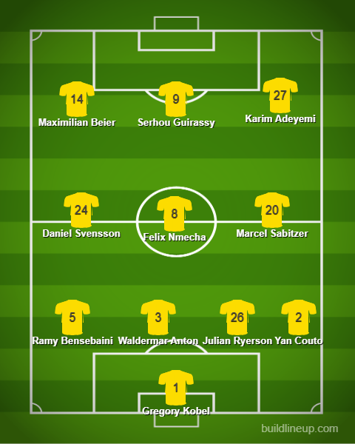
STARTING LINEUP
SCOUTING REPORT
FORMATION
1-4-3-3
RECENT FORM
Heidenheim 0 – 2 B. Dortmund | B. Dortmund 3 – 0 Union Berlin | St. Pauli 3-3 B. Dortmund | Essen 0 – 1 B. Dortmund
KEY INFORMATION
Injury List: Nicolas Sule out with calf injury, Emre Caan out with Groin injury ( Abduction Pain), Fabio Silva out with Groin injury
Suspensions: Patrick Drews, Salih Ozcan
League Positions: This the first game of the 2025/2026 UCL season. The
The starting formation was a 1-4-3-3, which eventually changed on the 30th minute to a 1-5-1-3-1 which gave them more bodies in the back and midfield to sustain Juventus Pressure in the first half. The formation in the second half changed to a 1-5-4-1, providing them cover at the back and increase the number of players in the final third.

Slide 5
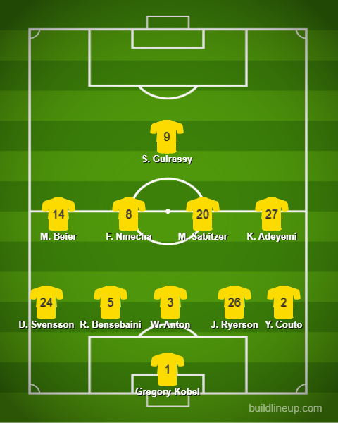
CHANGE OF SHAPE
SCOUTING REPORT
FORMATION
1-5-4-1
ADDITIONAL INFORMATION
This structure was used in the final quarter of the First half and a large part of the second half, as this enabled them to sustain pressure and be able to push players forward when needed.
When the press is on, they move very high up, with #9 and #27 and #14 staying on the edge of the box waiting to initiate the press. With #24, #8, #20 marking the players ahead of them in zones, as they are not fully committing to man marking.
While #26, #3, #5 and #2 stay in the center zones keeping a fair distance between them and the opposition players around them.

Slide 6
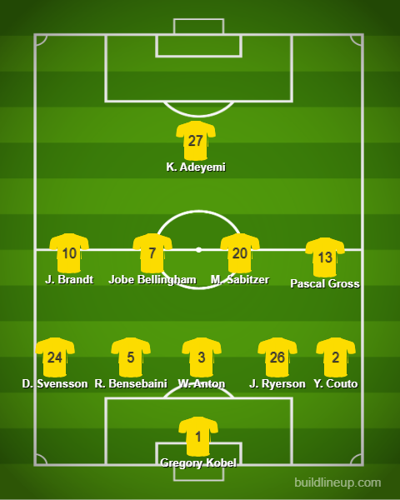
FINISHING SHAPE
SCOUTING REPORT
FORMATION
1-5-4-1
ADDITIONAL INFORMATION
In a bid to win and finish the game strong, this was their shape, as this gave them more bodies in the box and width for passes into the box when attacking, because they heavily depend on passing the ball into the box and final third.
#10 and #7 came on and were the game changers, as they were instrumental to keeping the attacking tempo high and finding #27, who every attack for Dortmund went through him, his passes lead to the goals and chances they created. #13 came on during the added time in the second half to help see out the game defensively.

Slide 7
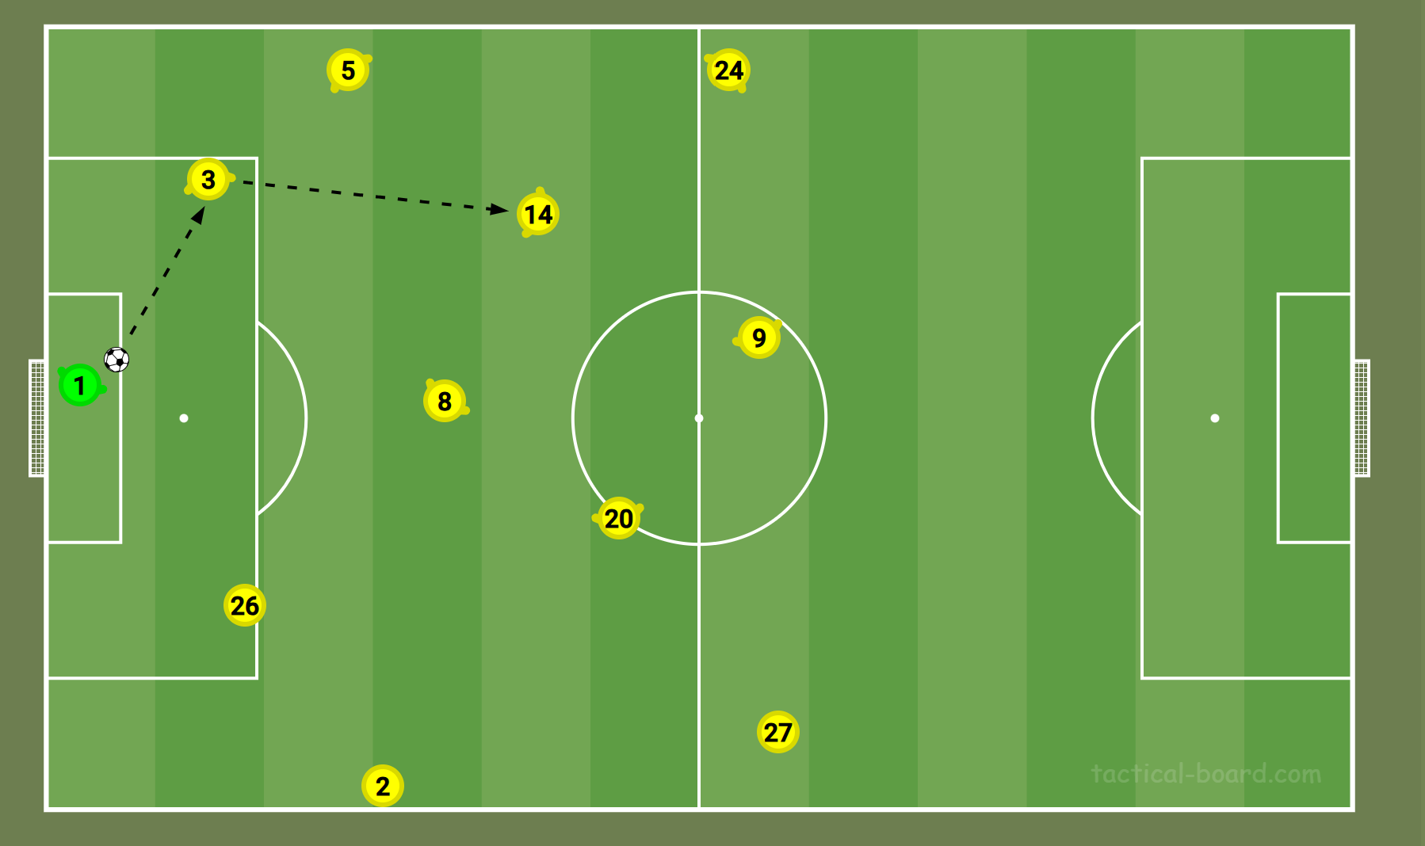
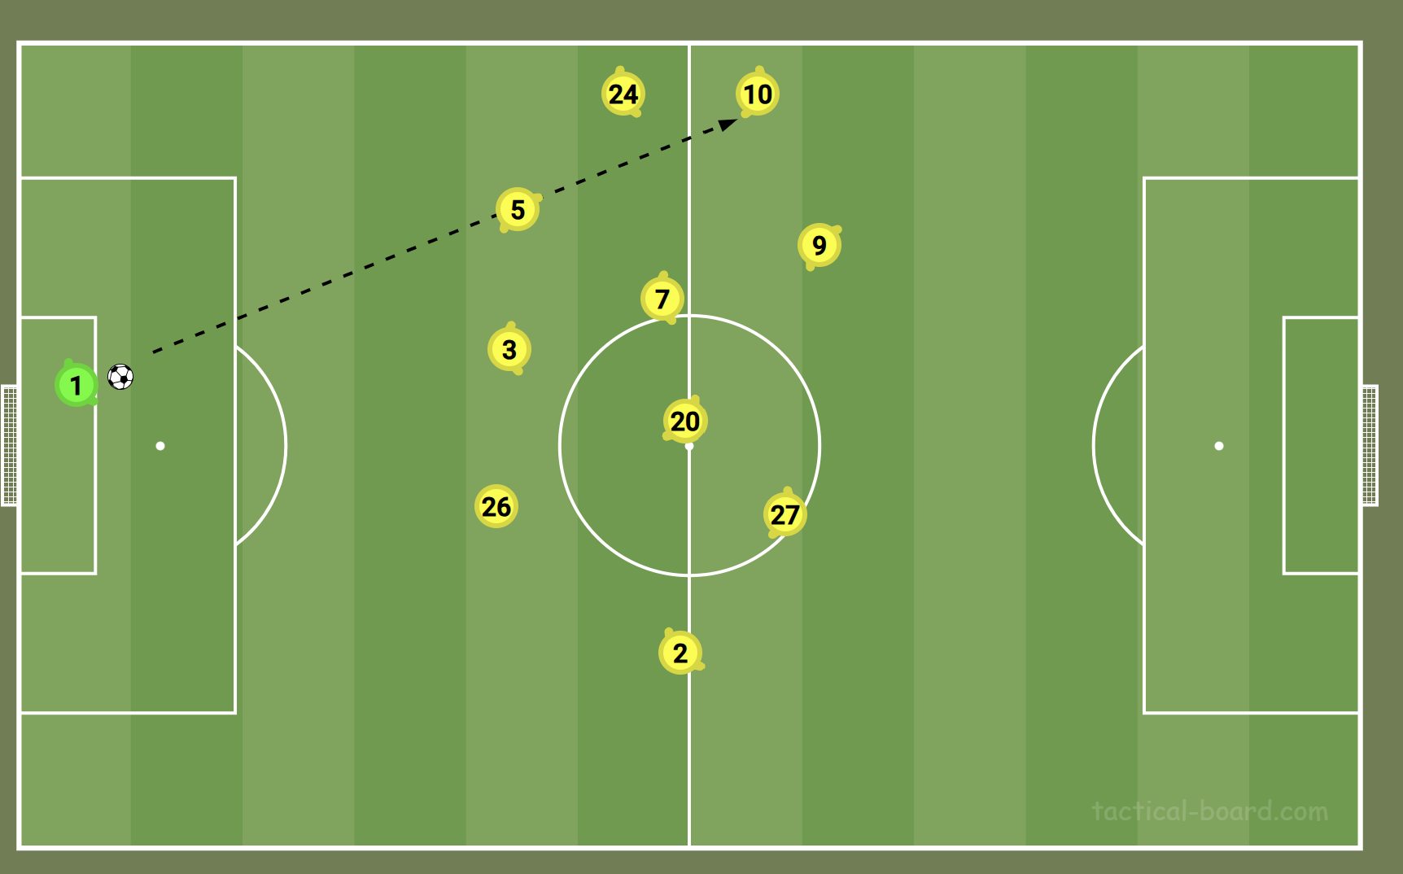
ATTACKING SHAPE
SCOUTING REPORT
GK RE-STARTS NOTES
From goal kicks, the ball is always played short to the CBs either #3 and plays it directly to #14 who always drops deep to receive the ball, as #24 opens wide, #8 comes short for support to retain possession in the midfield.
• Back line is pushed according to the movement of the ball, as they always aim to retain possession in their halfway and wide players and midfielders interchange position during GK restarts – this allowed Dortmund to have a lot of bodies around the ball should, either to retain or counter press the loss ball, so they were able to regain possession quickly.
• #5 and #8 were constantly alive to 2nd balls and were able to recover possession multiple times.
• This also meant that a turnover in possession gave Juventus a huge amount of space to reset possession to their GK or CBs behind to retain possession and invite the press, so as to have spaces behind the high press to exploit.
• When GK has ball in play – the CBs always move wide to receive the ball. The wingers come in to receive the second ball and pass to the nearest midfielder or FBs.
• GK hardly looks to throw long every time and the few times he did, was to the FBs who played it short to the winger.
• In the 2nd half GK restarts went long and straight to #10 who tries to flick it on for #9, to reduce the buildup time from the back.

Slide 8
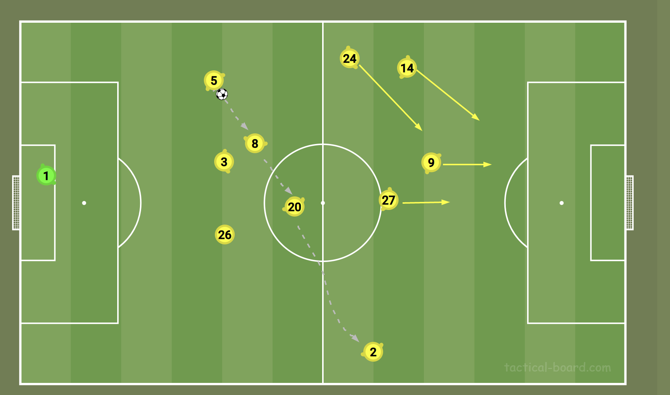
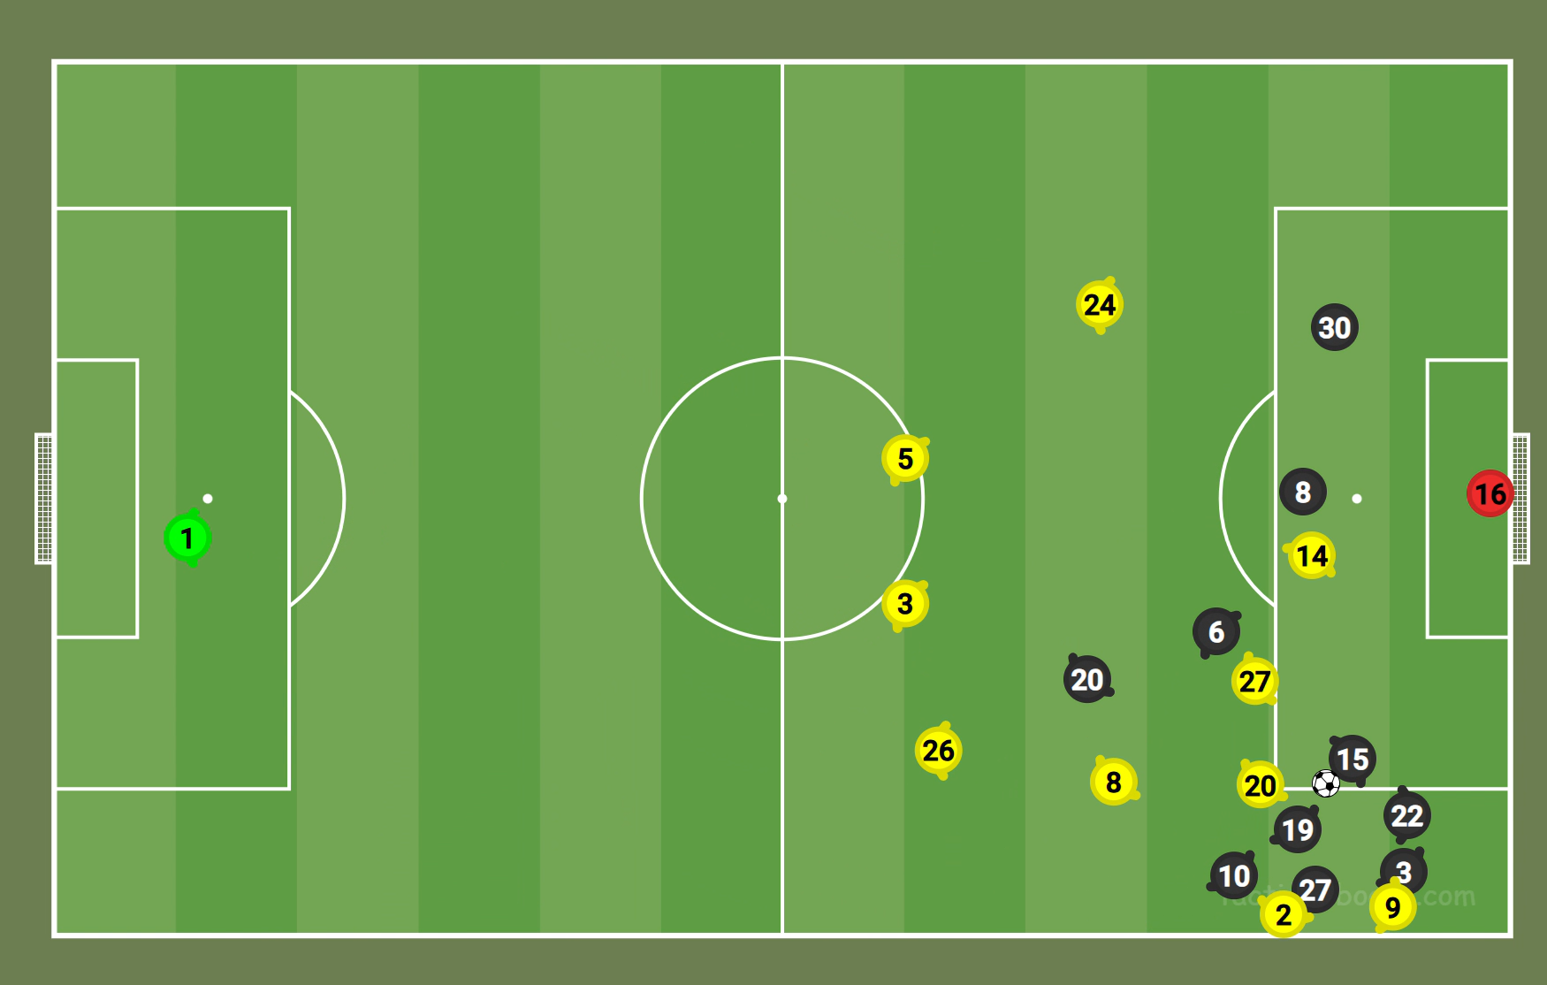
2nd PHASE MIDDLE THIRD
SCOUTING REPORT
NOTES
When playing in 1-3-3-4, balls were played to CB and plays it into the midfield.
• Little interchange of passing, as the passes in the midfields were more of creating spaces for 1-2s and trying to play out of the press while pushing forward.
• Retaining possession and dictating the play was the approach. Very few runners upfront, which limited the number of through balls played into the final third.
• The slow build up play, gave them numbers in the final third, and the short interchange created spaces behind the press.
Having more players moving into the final third, gave them control in the opposition half, where possessions was quickly regained and sent back to the GK to restart the play as shown by the animation here.

Slide 9
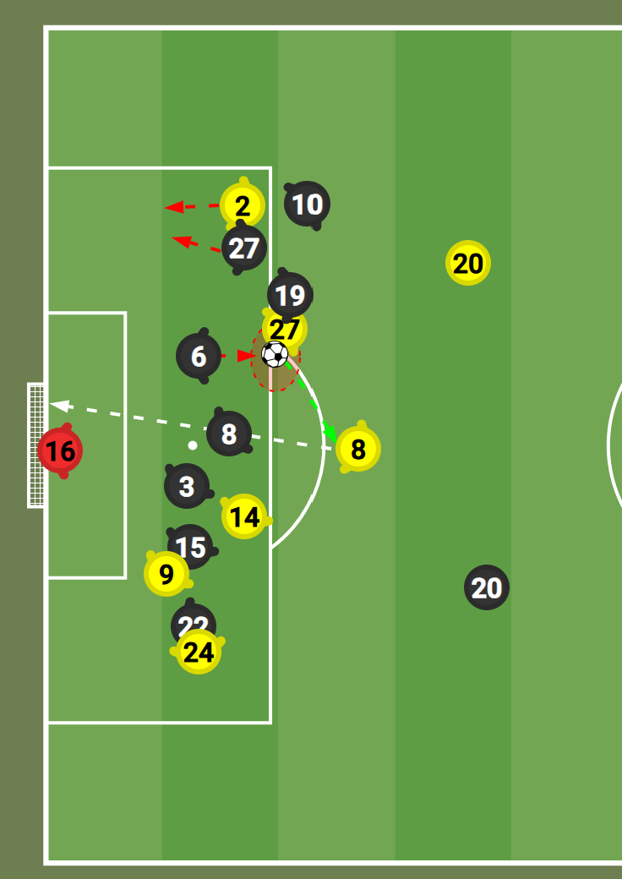
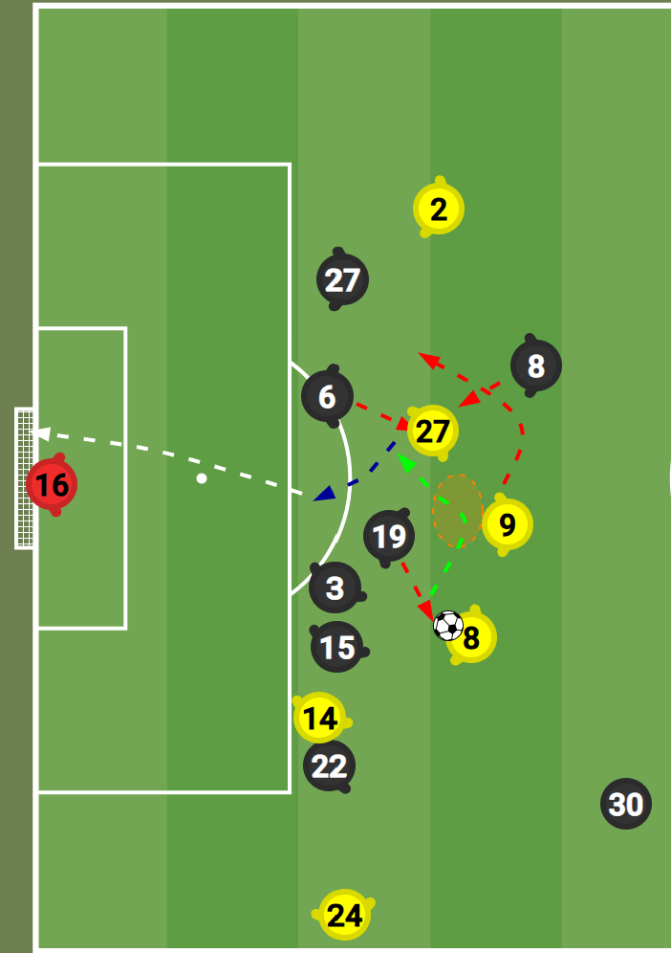
LAST THIRD SECURED POSSESSION
SCOUTING REPORT
NOTES
Their formation in the final third switched between 1-1-2-3-4 and 1-3-3-4, this was dependent on the position of play at the time, but they always had 4 players in the box for short passes or cutbacks into the box,
The buildup was majorly from the midfield, and this gave them more bodies in the final third when attacking. With short passes being played in the final third. They tried to look for spaces behind the defensive line with one-twos and into the feet of the attackers.
This approach provided more bodies to win the 2nd balls being cleared out or when the passes gets intercepted.
The opposition provided little or no spaces enough for the short passes or one - twos to work, so Dortmund players decided to take shots from outside the box, and this resulted in the first 2 goals they scored. As illustrated with the images.
#2 originally gave the pass to #27 for a quick interchange, his run was tracked and #27 tried to dribble, when there was no space, he passed to #8 who curled it to the top corner immediately, giving them the lead again. Fig.1.1
The first goal for Dortmund came because of, moving the ball around quickly, before Juventus could close the space. #8 got the ball and drove forward, the moment #19 tried to mark him, he quickly passed to #9, who played it quickly to #27, #27 dribbling passed the oncoming #6 and #8, before beating the goalkeeper at the near post with a low driven shot. Shown in Fig1.2

Slide 10
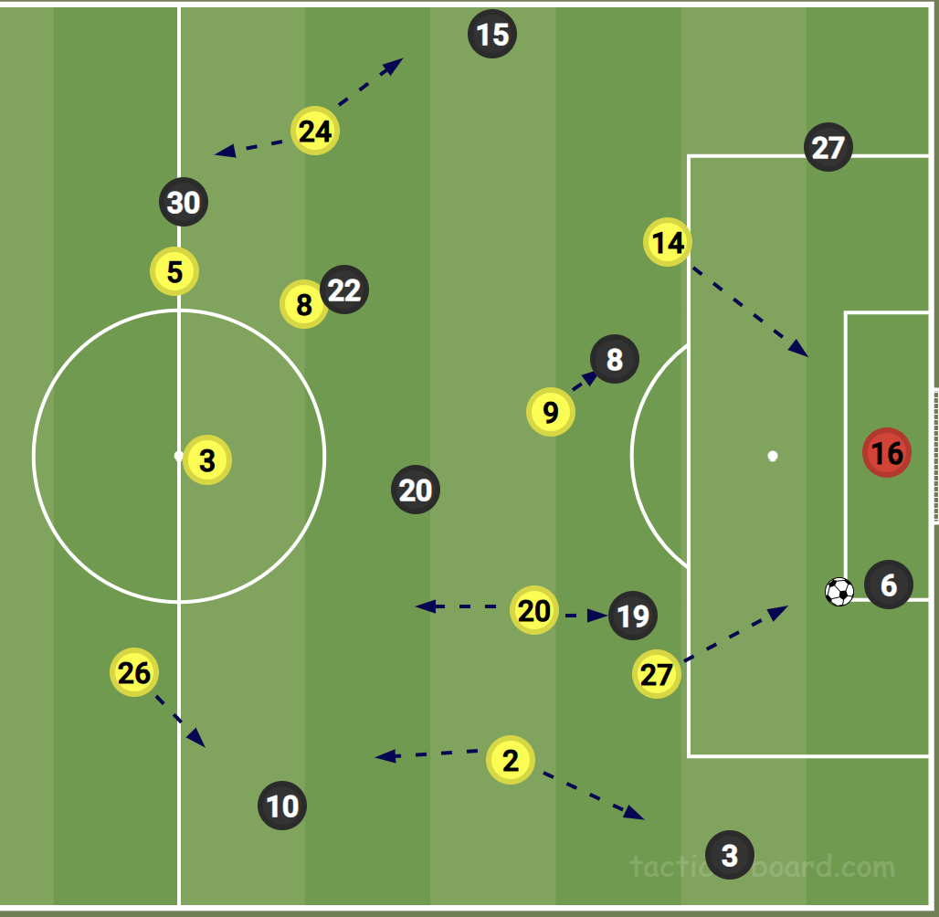
DEFENSIVE SHAPE FROM OPPOSITION GK
SCOUTING REPORT
DEFENSIVE SHAPE NOTES
Opposition GK always tried to play it short, before playing it into the spaces left behind the press. The GK was always available for passes, in other to restart play.
The ball is played short to the GK, #27 initiates the press to #6, making his own player #20 to mark #19, while #14 presses the GK and block the passing lane to #27. However, the GK plays it to #20 who is free, bypassing the press and finding a free player behind the pressing line. The Press wasn’t always effective as the ball was either played to #20 or #10 behind the press, or the press wasn’t quick enough, which was always the case.
The formation when defending from the opposition GK was 1-3-2-3-2. Even when the opposition GK plays it long, the formation remained the same.
In the 2nd half the press got quicker and covered the spaces left behind faster with #20 pressing most of the balls in midfield and other players pressing and marking in their zones.

Slide 11
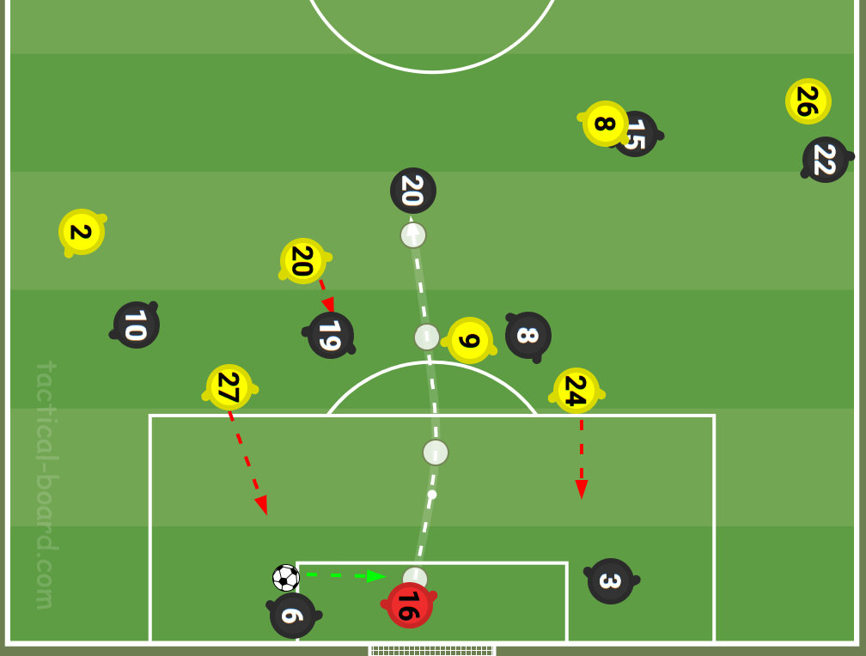
DEFENSIVE SHAPE FROM OPPOSITION GK
SCOUTING REPORT
DEFENSIVE SHAPE NOTES
A high line meant lots of spaces behind midfield, after they go for the press and a huge space behind the defensive line for direct balls into the space behind.
They constantly tried man marking in zones and kept a high line all through.
The high line and press wasn't effective as Juventus could easily play through the press or dropped the ball behind the midfielders for their players to take possession. Which meant Dortmund midfielders were always running behind the ball, rather than being able to tackle or mark who is with the ball. Which is illustrated by the image.
The GK is played short by the CB to his Goalkeeper. #27 initiates the press and #24 moves to mark the other CB, with other players marking those in their zones. The goalkeeper plays a looped pass over the press to #20.

Slide 12
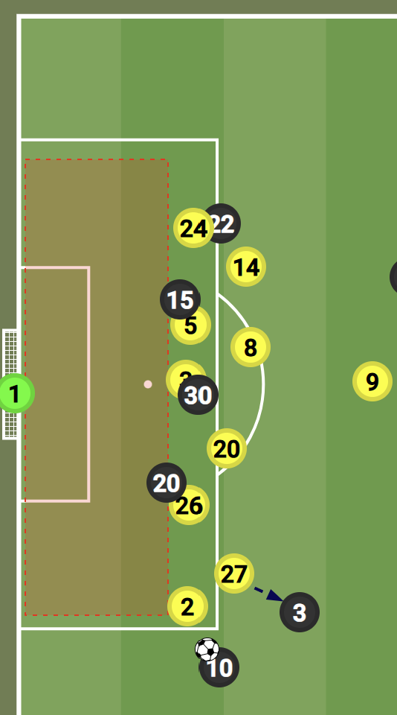
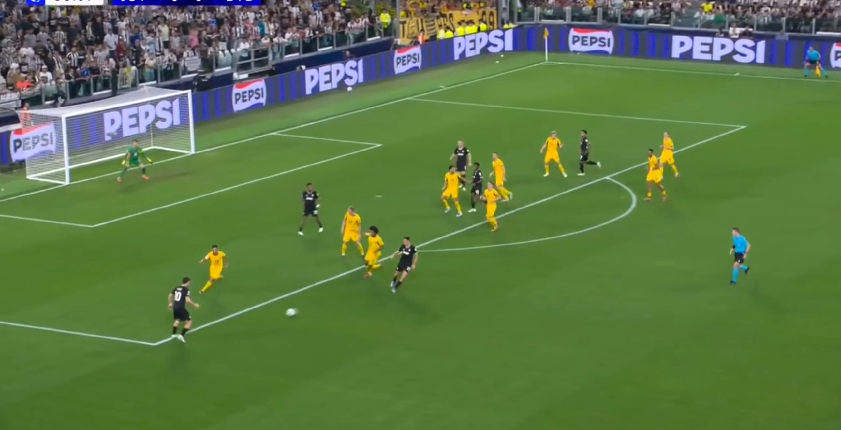
DEFENSIVE SHAPE LAST THIRD
SCOUTING REPORT
DEFENSIVE SHAPE NOTES
The formation changed between 1-5-1-3-1 and 1-5-4-1, which was heavily reliant of the position of the ball in the last third.
They maintained a very mobile low block, with the midfielders providing little spaces between them and the defenders. When the ball moved up, the defensive line also followed to stay as high away from their GK as possible.
Due to their mobile block in the final third, there were always spaces behind the defensive line to exploit, as illustrated with the image here. However, the defensive line was effective in catching the Juventus players offside.
When the numbers were enough at the back, they all moved as a compact line close to the ball, with very little space between the first line of defense and the second line. With players making in the zones, they find themselves. The 4 players forming the second line were clearing or mopping up the balls that drop to their zones. As shown by the video below.

Slide 13
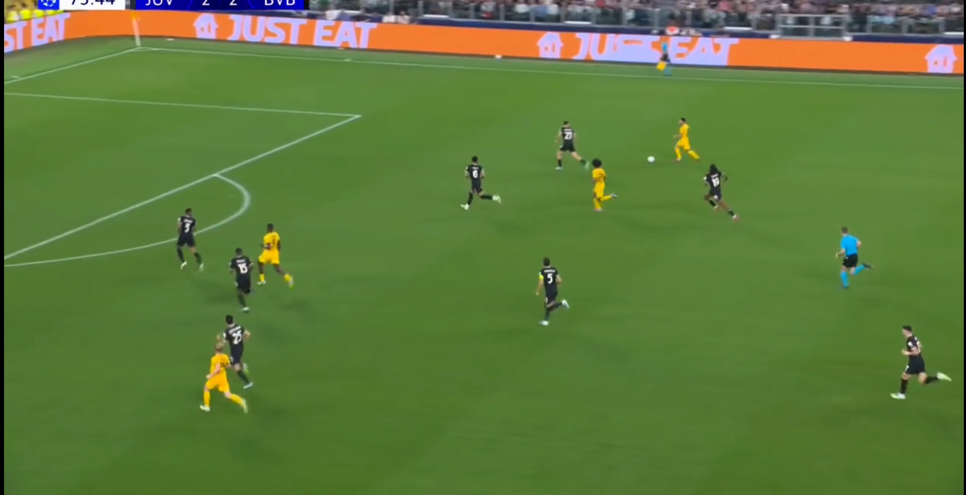
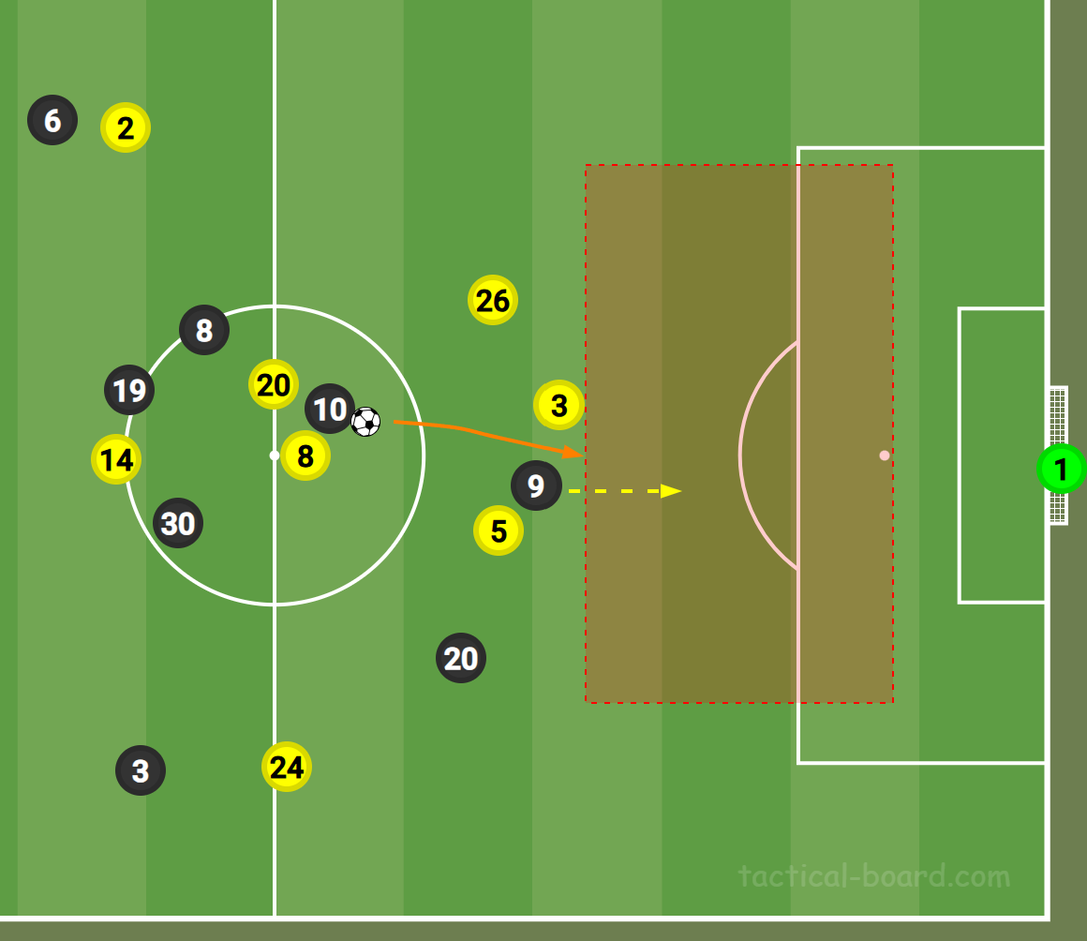
DEFENSIVE ANALYSIS
SCOUTING REPORT
GENERAL COMMENTS
STRENGTHS
WEAKNESSES
Keeping it simple at the back would have helped them secure a win in this game. Failing to clear the ball early and properly, meant loss of possession in the last third, which also broke the offside trap, as it was a turnover in their last third.
Very effective defensive line and offside traps
More bodies in the press to prevent Juventus from playing from the back.
More players in the opposition half, meant quick turnovers in attacking position when they win the ball high up. This led to them scoring 2 goals from this situation. As shown by the video below.
Relapse on the players towards the final moments of the game, saw a breakdown in the offside traps as players failed to step out quick enough.
Very high pressing line, gave lots of spaces behind the defensive line for Juventus to exploit, which was evident in the goal the conceded. As shown by the image below. With #10 playing the ball into space for #9 to attack and finish.
The defensive shape was more about reducing spaces in the box, but gave spaces in front of the box for Juventus players to shot from with no press or pressure from anyone, which led to another goal conceded
DIAGRAM/CLIP
DIAGRAM/CLIP

Slide 14
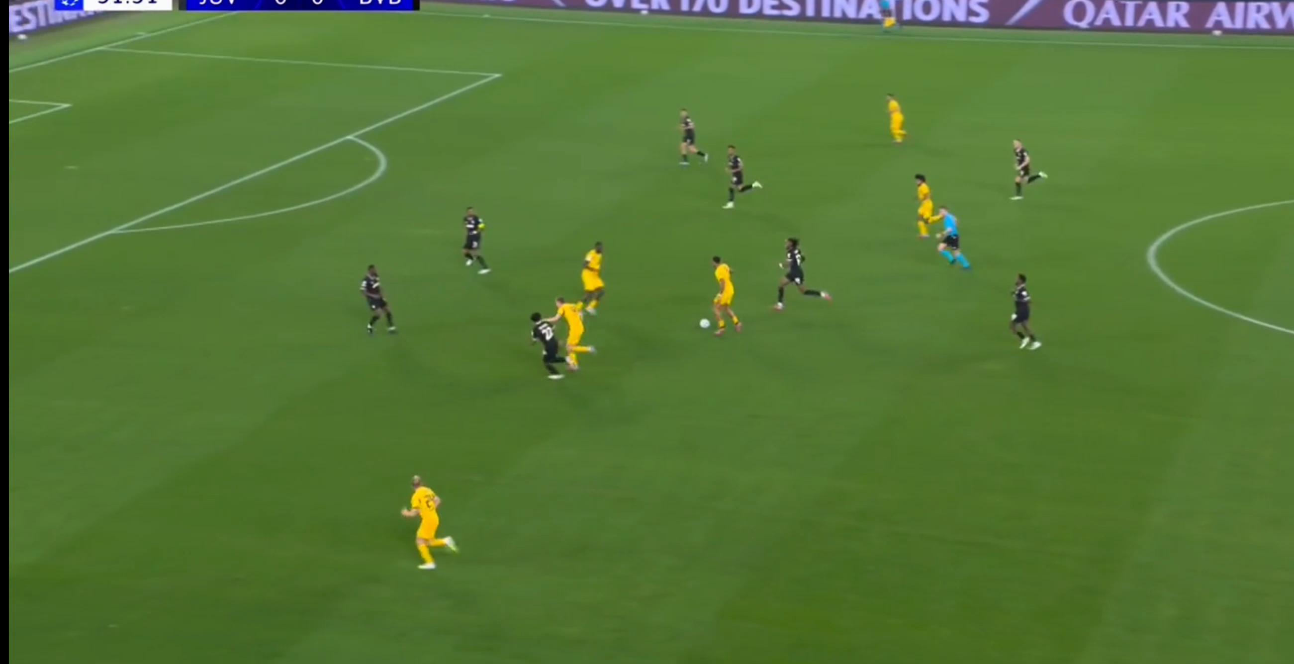
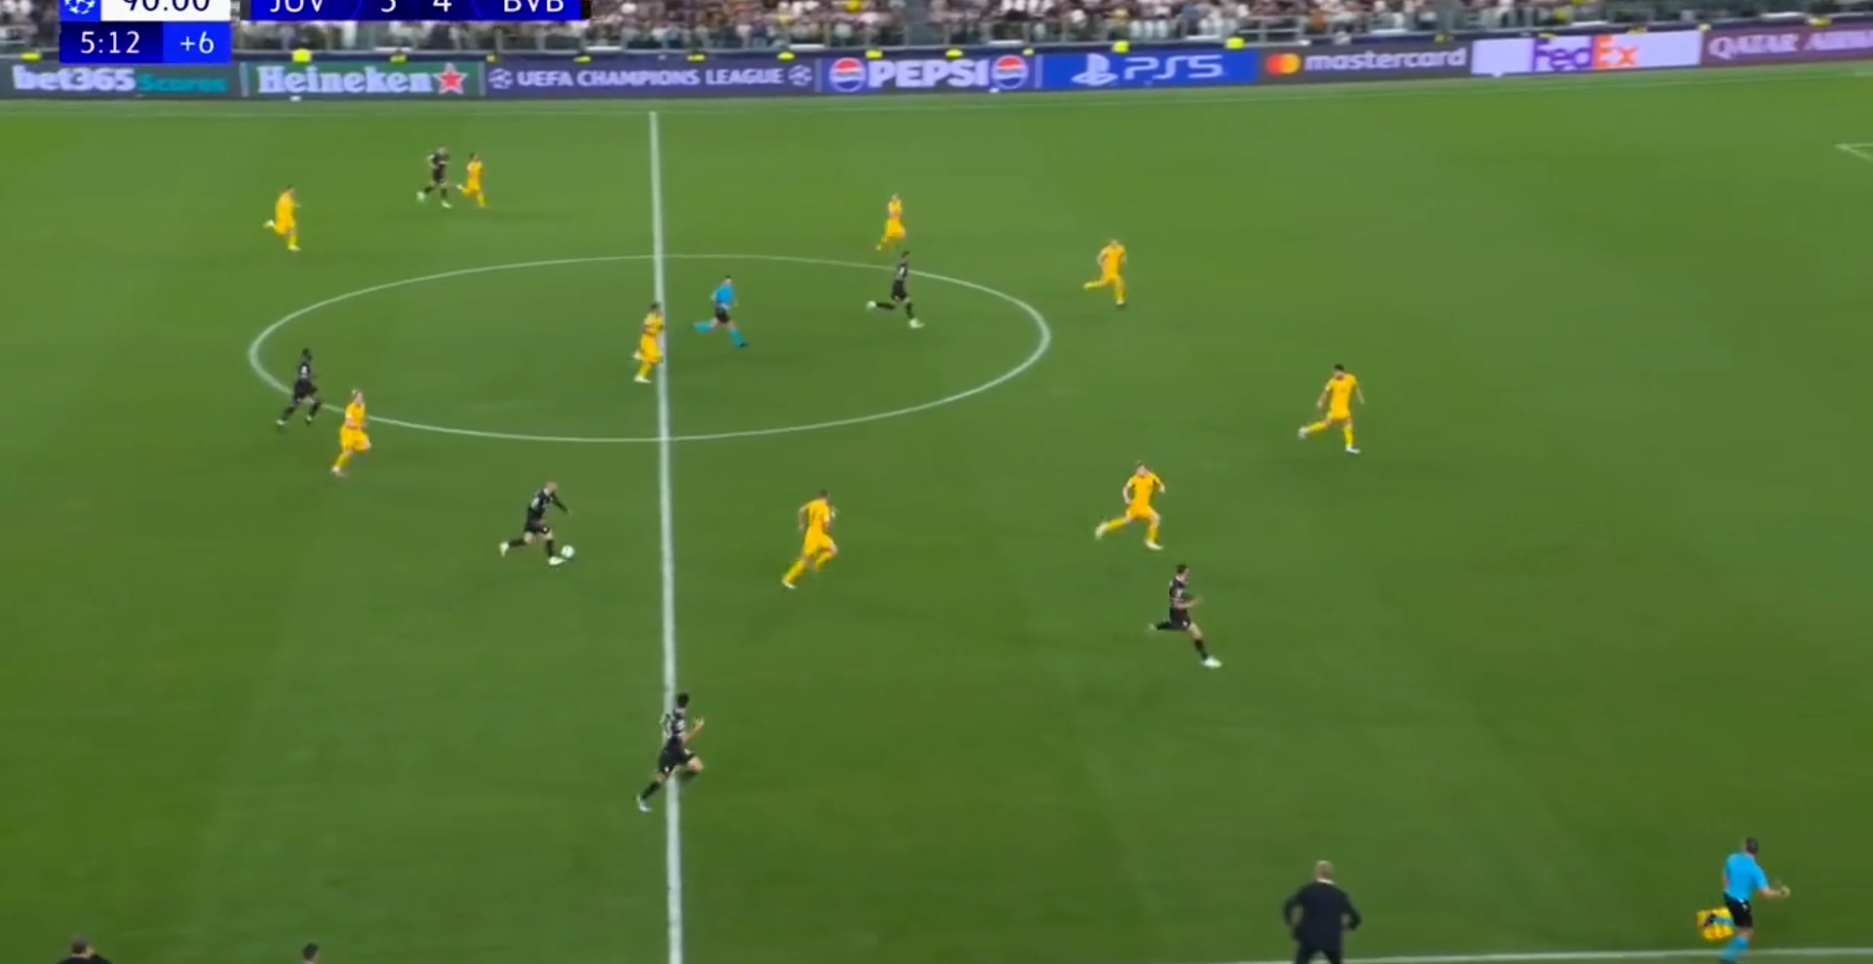
ATTACKING ANALYSIS
SCOUTING REPORT
GENERAL COMMENTS
STRENGTHS
WEAKNESSES
Failed to control the game in the final moments, as they sent more bodies forward with a 2 goals lead. Due to this reason, they lost their shapes and effectiveness at the end of the game and drew the game with few minutes to go.
Good possession and ball retention.
Quick short passes to create spaces in and around the box
More bodies in the final third gave them rooms for one twos to beat markers and create shooting spaces, with the illustration below.
Failure to make the huge number of players in the opposition box count by not crossing quicker or crossing at all. As the gameplay were short passes
Loss off possession meant highline and spaces behind the line for counter or long balls.
Having a lot of players forward occasionally meant slower defensive shape recovery or retention as players are still running back into positions, as this was the case for the final goal conceded. As shown below.
DIAGRAM/CLIP
DIAGRAM/CLIP

Slide 15
GENERAL ANALYSIS
SCOUTING REPORT
How many players do they have in midfield? | This varied between 4 to 3, which was dependent on the opposition's gameplay.
How deep do the flanks play? Attacking or defending? | They played high up when attacking and tucked in deep when defending.
How tall is the GK and how is he with crosses? | He is 1.96m tall and is good with the crosses and getting the ball in the air.
Does the GK throw the ball out and if so who is willing to accept it? | He always played or threw it short to the CBs
Do they build up from the back, through midfield or direct to the final 3rd | In the 1st half they played from the back, while in the 2nd half the went directly with long balls.
How well and early do they pressure the ball | They pressed early, right from the goal kicks restarts.
Do they have any quick players | Yes, #27 , #9
Do they have any aggressive players | #2 aggressive
Is there anyone frightened of a challenge | None noticed in this game.
Were there any penalties and if so who took them and where did he place it | Yes, there was a penalty, lots of fuss over who to play it. #5 eventually played it, after Managers intervention. He played it to his bottom left, after pausing midair before playing the ball with his kicking foot,
Is there anybody who did not play today that should have? | Emre Can out injured.

Slide 16
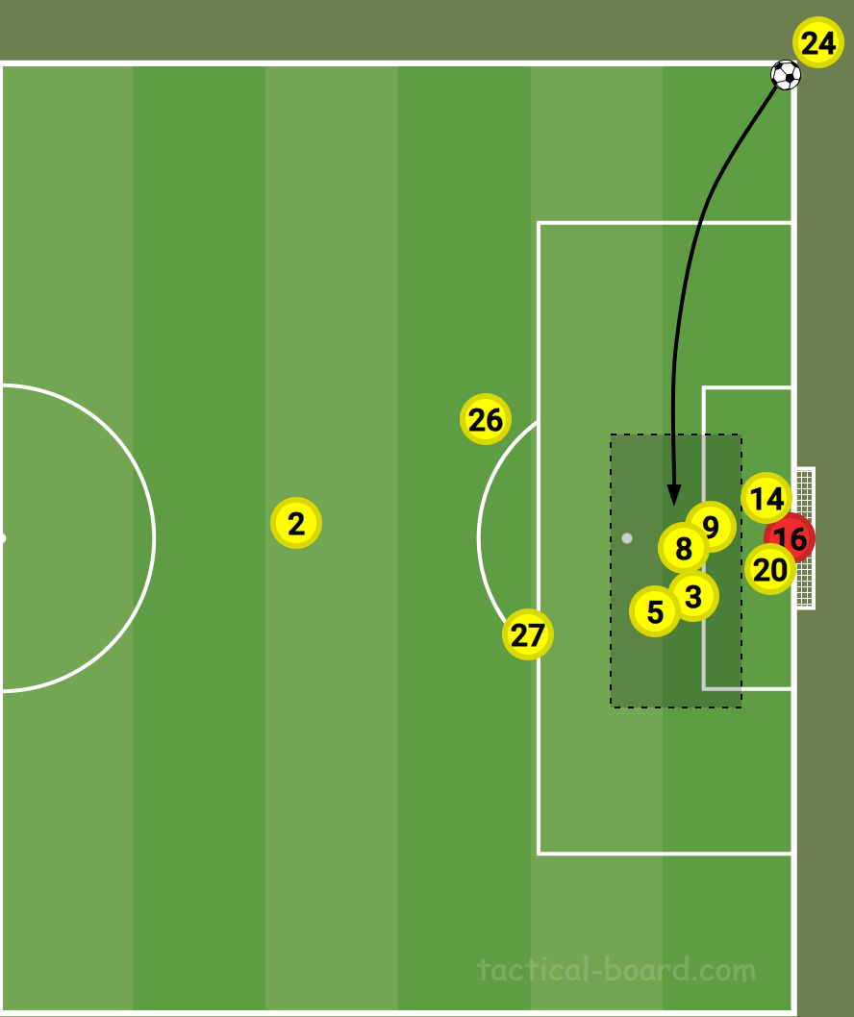
ATTACKING SET-PLAY ANALYSIS DIAGRAM
SCOUTING REPORT
NOTES
Corner Kick set-play
#24 is the set piece taker
#14 makes a run to the front post for a header
#9, #8, #3 all contest for the header in the middle of the box.
#5 runs towards the back post
#2 takes a defensive position
#27 and #26 waiting at the edge of the box to attack/defend the ball
The corner routine gets cleared away.

Slide 17
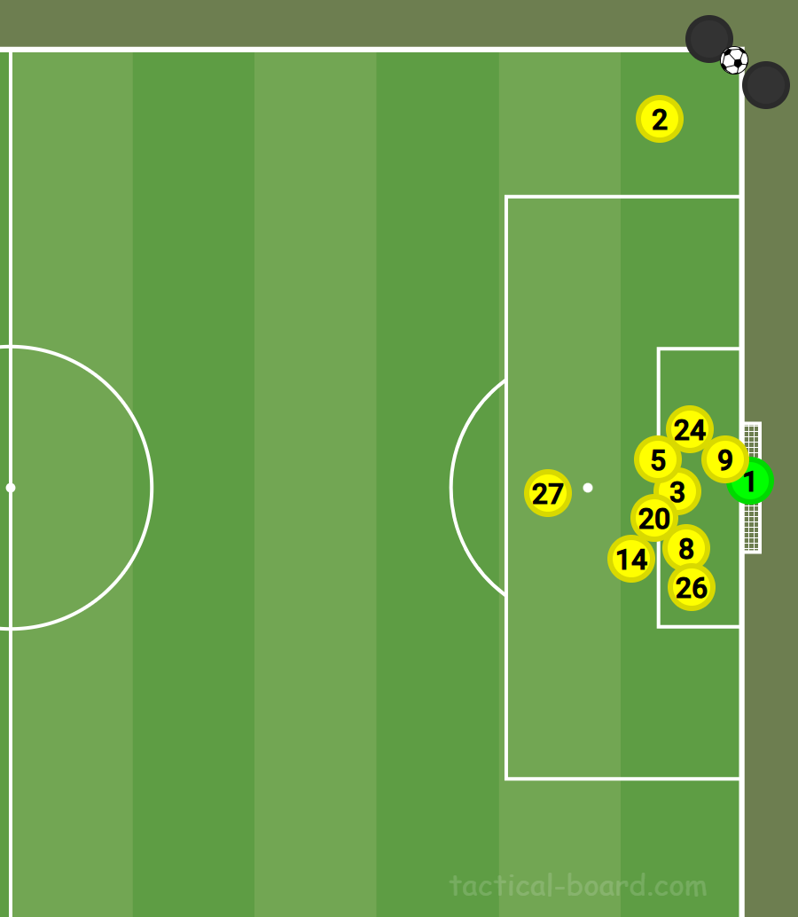
DEFENDING SET-PLAY ANALYSIS DIAGRAM
SCOUTING REPORT
NOTES
Corner Kick set play
#2 stays close to the taker to prevent a short corner routine
#27 stands at the top of the box, to prevent it being played outside .
#5, #20, and #3 marks the best headers from Juventus
#8, #14, #13 marks other Juventus players
#24 Marks the front post, while #26 marks the back post for balls and runners into the back post. While #9 steps to the center of the box to give goalkeeper spaces to clear ball.
Goalkeeper stands alone with spaces to come collect or punch the ball
The corner routine is played to the middle of the box, and it was cleared easily by #3.

Slide 18
PLAYER ANALYSIS
SCOUTING REPORT
No | NAME | COMMENTS
1 | Gregor Kobel | Always came out for the corner kicks and is decent in the air. Good with the ball and was a good outlet for retaining possession for his team.
2 | Yan Couto | Always looking to dribble, rather than pass the ball. A great attacking threat, with a nice taken shot into the net, when he scored. However, he stayed with the ball too long and lost possession couple of times.
3 | Waldermor Anton | Good communication, as he often called his teammates attention and awareness to the player or situation around them. Got a yellow card for a technical foul, breaking up a one two that could have brought about a counterattack with a 1v1 situation against their GK.
5 | Ramy Baensebaini | Good defensive cover and was generally good on the ball. Well, taken Penalty kick. Good tracking and awareness of players around him, which was instrumental in intercepting a key pass on the 20’51 min to prevent a goal scoring opportunity. However, he failed to clear the ball in the final minutes and optioned for a pass in the defensive third, which got intercept and brought about the 4th goal they conceded for the game.
8 | Felix Nmecha | Good on and off possession, tracked runners behind and around him. Kept his passes neat and simple. Scored their second goal, immediately they conceded, curling the ball to his right, with the goalkeeper thinking the ball was going out. He was substituted on the 70’18min for Jobe Bellingham.
9 | Serhou Guirassy | Always a good outlet when attacking, running into channels, ready to receive the ball in the middle third. Good through ball to Adeyemi to create a goal scoring chance for the team. He was a constant threat in the final third, available for short passes and it took a great save to keep him off the score sheet in the game. Got substituted on the 90+2mins for Pascal Gross.
14 | Maximilian Beier | Constantly pressing and marking players in his zone, was good with the ball and helped the team in retaining possession. He was substituted in the 2nd half for Julian Brandt on the 70’19 min.
20 | Marcel Sabitzer | Was always available as an outlet in the midfield. Constantly pressing forward and tracking back. Was not scared of committing into tackles, which was instrumental in creating attacking turnovers that led to goals.
24 | Daniel Svensson | Good positioning, good in the air and good ball retention. He was vital in their possession gameplan.
26 | Julian Ryerson | Good tracking and awareness of players around him, defensively sound and good in the air.
27 | Karim Adeyemi | His pace and dribbling ability was a problem for the opposition all through the game, most of their attacks in the final third went through him. He scored their first goal and assisted their 2nd goal.

Slide 19
PLAYER ANALYSIS
SCOUTING REPORT
No | NAME | COMMENTS
8 | Jobe Bellingham | Very good and assured on the ball, brought a different dimension to how they attacked as was vital in their equalizer.
10 | Julian Brandt | He was the main outlet for the GK longballs. Good on the air, as we won some aerial duels when the goalkeeper went long. Good with the ball and created the chance that brought about the penalty. Always willing to run behind the defensive line.
13 | Pascal Gross | He was brought on to help the team see the game out, unfortunately he could not make much impact in the game when he came on.
ADDITIONAL INFORMATION

Slide 20
GAME ASSESSMENT
SCOUTING REPORT
Dortmund started the game with a good gameplan to limit the chances and spaces for Juventus to play with. This brought about a tight 1st half, as both teams were limited to fewer chances being created. Occasionally, Dortmund players marked in clusters, thereby blocking the Juvebtus players with the ball from seeing or being able to playout easily. Meanwhile, this was also the case when attacking, as they sometimes played in clusters thereby boxing themselves in each others path and losing possession.
The 2nd half saw a change in approach as Dortmund moved the ball faster and every attack went through Adeyemi, which resulted into more chances created and goalscoring opportunities being exploited. A faster ball movement resulted into 3 goals and a penalty scored. However this is also left them exposed, as they continued to press with numbers forward, they left spaces at the back for counter attacks. Possession was lost in the middle third and a forward pass released Juventus striker to run into a 1v1 situation to score. They had a very mobile backline, which constantly stepped out fast as the ball changes direction, but a poor pass in the defensive third rather than clearance, meant Juventus won the ball deep, and a quick cross into the box caught their offside line out of shape, this was evident in the last 2 goals they conceded in stoppage time.
Lack of proper game management cost them the game, as they went into the stoppage time leading 4-2. A good ball retention would have seen them win the game. After conceding the 3rd goal, they pushed more players forward to score a 5th goal rather than see the game out. They lost possession andshape and conceded a 4th goal at the tail end of the game.
Good gameplan and poor game management cost them the win in this game.

Slide 21




www.thepfsa.co.uk |   

